Slide 1





GSIAF &
Anar Manafov, Victor Penso, and Kilian Schwarz,
GSI Darmstadt,
ALICE Offline week, 2009-03-18
v. 0.8

Slide 2








GSI Grid Cluster – present status
CERN
GridKa
1 Gbps
80 TB
ALICE::GSI::SE::xrootd
Grid
vobox
Grid
LCG RB/CE
CE
GSI batchfarm: ALICE cluster (180 nodes/1400 cores for batch: 20 nodes for GSIAF)
Directly attached disk storage (112 TB)
for testing purpose
PROOF/Batch
Lustre Cluster:
130 + 160 TB
GSI batchfarm: Common batch queue (132 nodes)
GSI

Slide 3
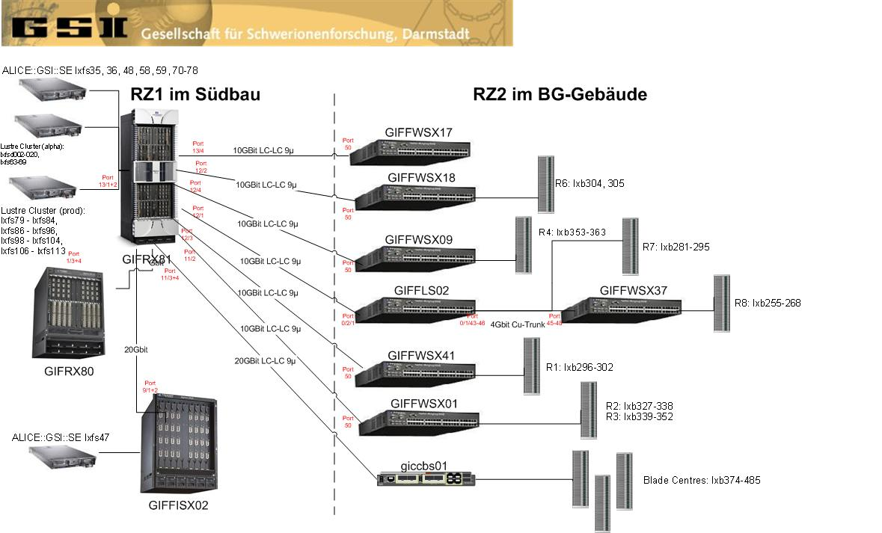
GSI T2 – network topology

Slide 4
GSIAF
dedicated PROOF Cluster GSIAF
20 nodes (160 PROOF servers per user)
Reads data from Lustre
used very heavily for code debugging and development
  needed for fast response
  using large statistics
Performance: 10^6 events (200 GB) analysed in 10 minutes

Slide 5
Configuration (GSIAF)
setup: 1 standalone, high end 8 GB machine for xrd redirector and proof master, Cluster: LSF and proof workers
so far no authentification/authorization
via Cfengine
  platform independent computer administration system (main functionality: automatic configuration).
xrootd.cf, proof.conf, TkAuthz.Authorization, access control, Debian specific init scripts for start/stop of daemons (for the latter also Capistrano for fast prototyping)
all configuration files are under version control (SVN)

Slide 6
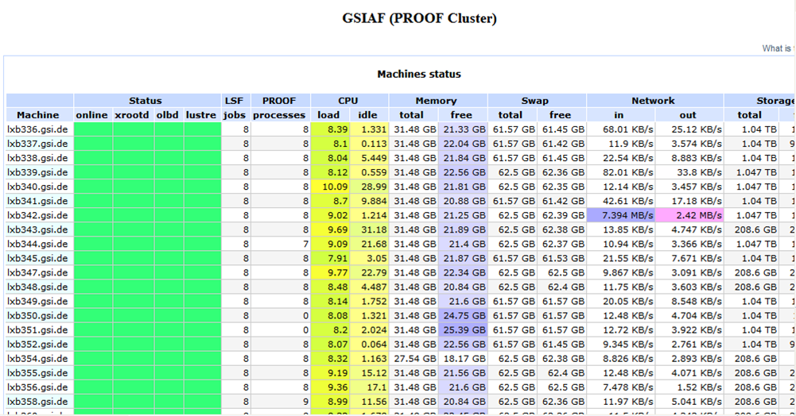
Monitoring via MonaLisa

Slide 7
GSIAF -----> PoD

Slide 8
Motivation for PoD
Design a toolset to setup a PROOF cluster on-the-fly.
The main goal is to make it transparent, simple in use and extensible.
Use and combine Grid/Batch resources.

Slide 9
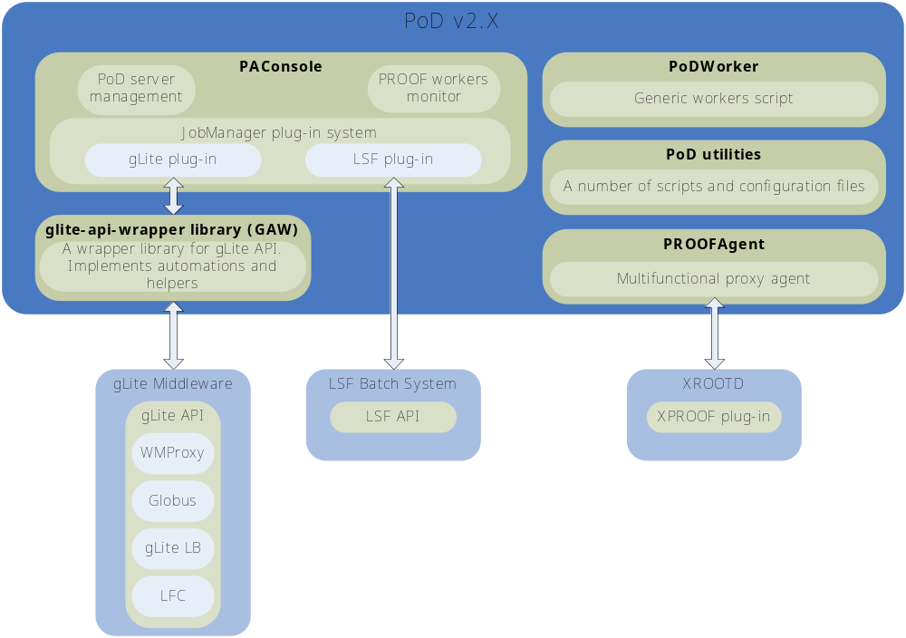

Slide 10
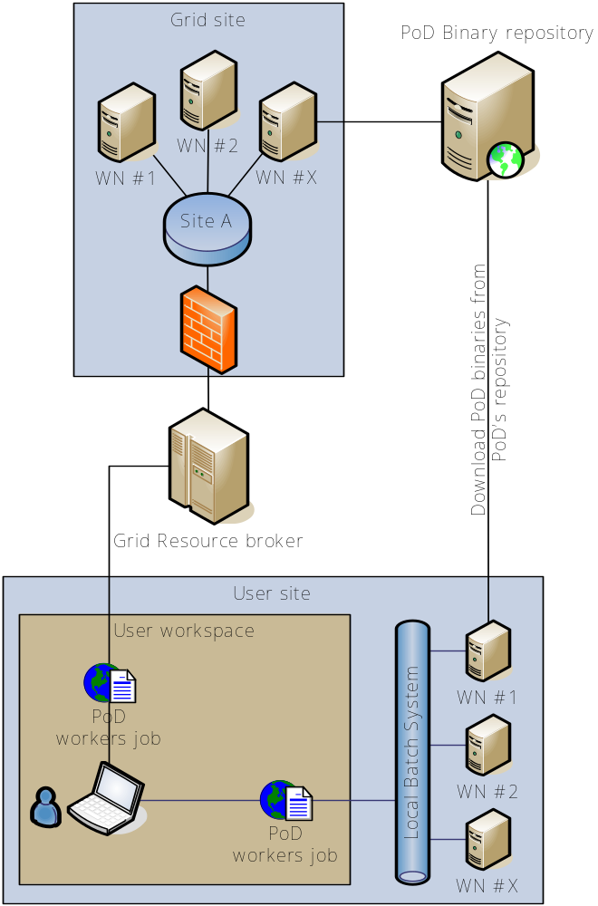
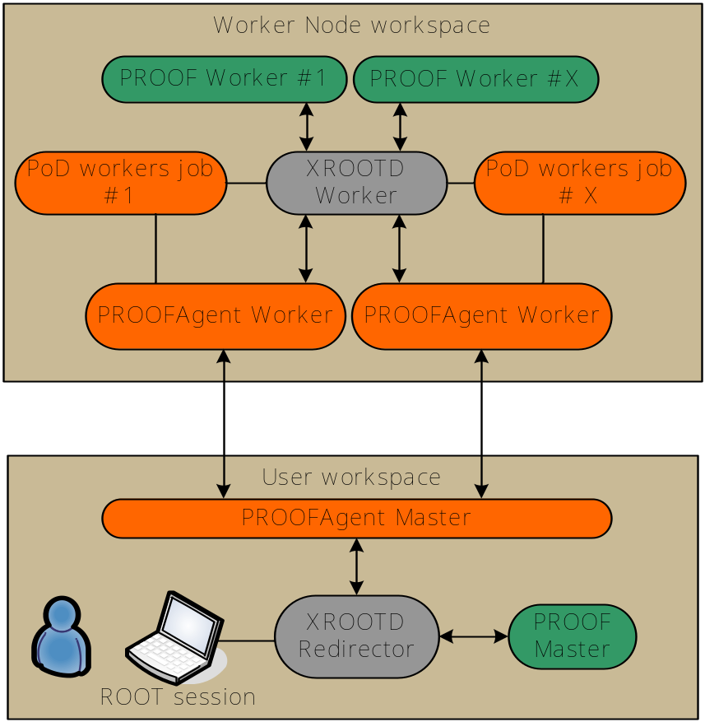


Slide 11
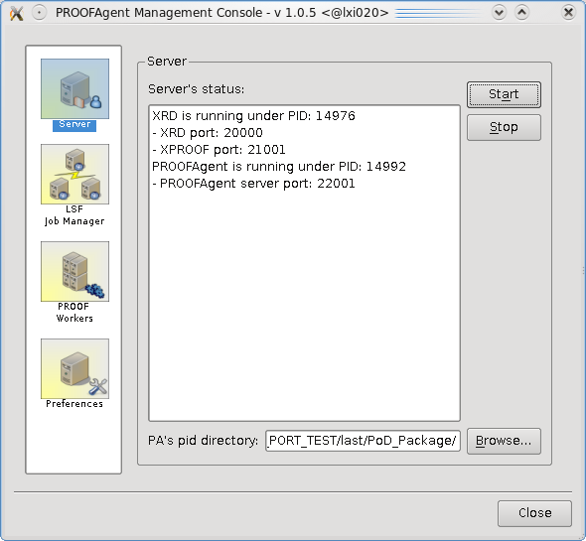
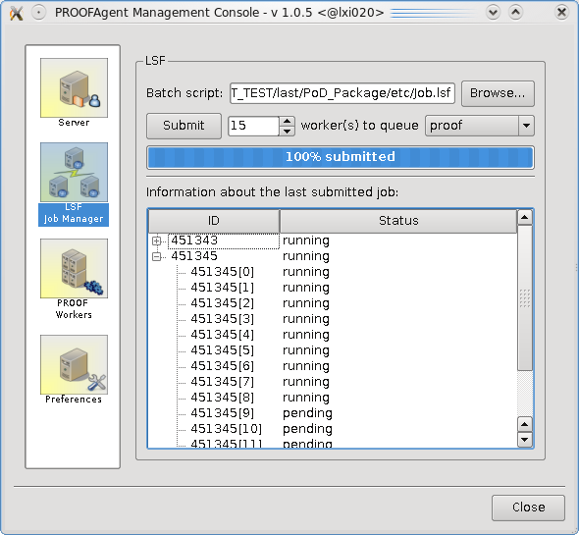
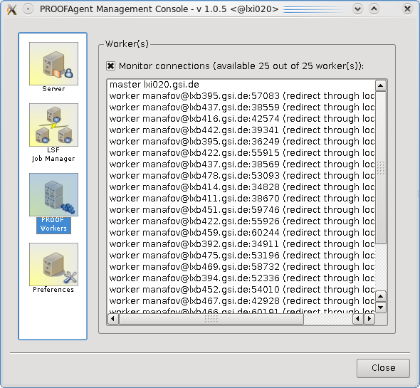
PAConsole - a GUI of PoD

Slide 12
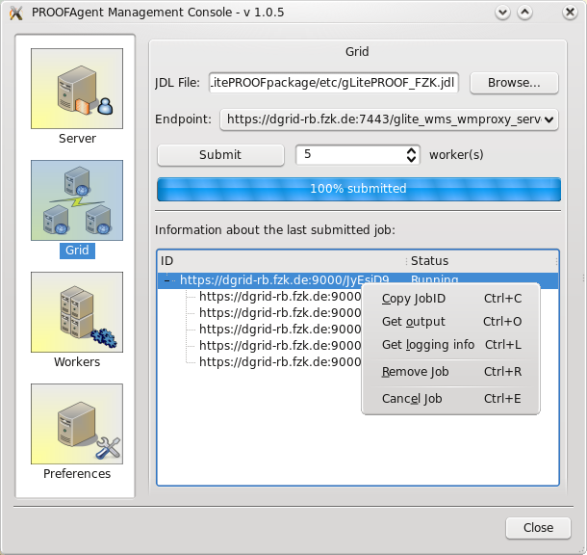
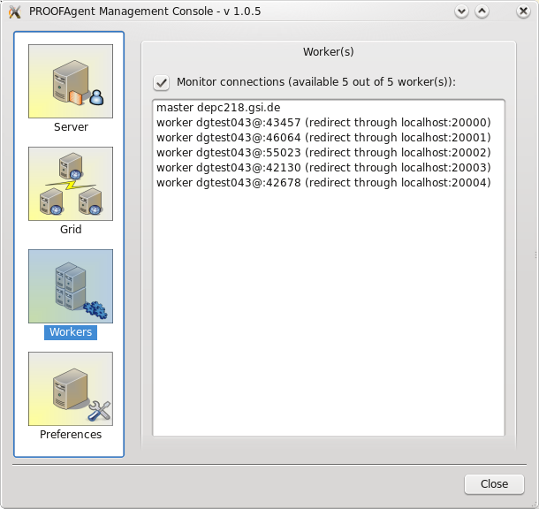
PAConsole - a GUI of PoD

Slide 13
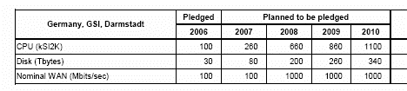
Plans for the Alice Tier 2&3 at GSI: ramp up
+1/3 for the use of the surrounding universities (tier 3)
Future FAIR T0/T1 centre profites from experiences gained with ALICE T2 centre

